Slide 1
Nexus Liftloop
ZF Hackathon 2024
Ravikindi Sri Jagadeesh
Shajahan Mohammad
Aman Kumar
Singh Sahil
Kadam Pratiksha

Slide 2
Problem Statement
Major Challenges: Pollution, Resources outage, Climate changes.
Traffic Congestion: Heavy traffic during peak hours causes delays and increases stress levels among employees.
Environmental Impact: High levels of vehicle emissions contribute to environmental pollution and health concerns.

Slide 3

Solution
Lift Loop Solution: Introducing Lift Loop, a comprehensive solution designed to improve transport for office commuting.
Optimized Routes: Develop optimized transport routes that cover more areas and reduce overcrowding, ensuring a more comfortable commute.
Safety Measures: Enhance safety features, such as better lighting at stops and increased security personnel, to ensure a safe commute for employees.
Flexible Scheduling: Offer flexible scheduling options to accommodate different work hours, reducing peak time congestion.

Slide 4
Technology Stack
Frontend:
Angular material: For building the user interface.
HTML/CSS: For structuring and styling the web pages.
JavaScript: For adding interactivity to the web pages.
Backend:
Node.js: For server-side scripting.
Firebase: Database
Tools:
Git: For version control.
GitHub: For code repository and collaboration.
Postman: For API testing.

Slide 5
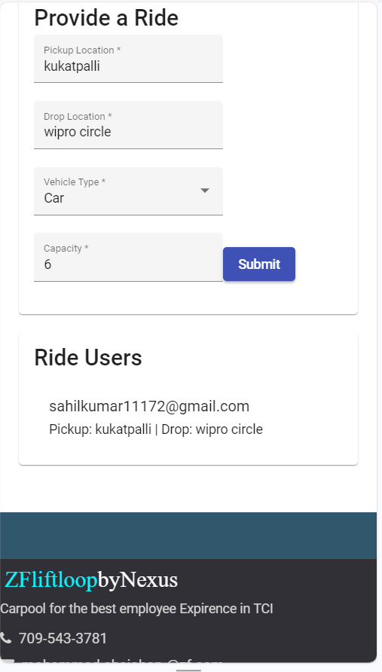
Demo

Slide 6

Future plan
we have used Firebase data base its adequate for 3k users.
Integrating Open-source API: For location services.(can optimize the distance cluster (size: 500meters).
Optimizing the Run and load time.
Riders' incentives for facilitating the commute.

Slide 7

Thank you

